Slide 1
GCAM模型介绍

Slide 2
1
综合评估模型
Table of Contents
2
GCAM的基本结构
3
GCAM simple tutorial

Slide 3
综合评估模型正成为可持续发展研究的新范式
Input-output, Life-cycle assessment, Material Flow, Regression analysis
Essentially, those approaches are all empirical based industrial ecology approaches.
But the fast-changing world is posing stronger and more frequent shocks to human society.
(COVID-19, US-China trade war, Brexit)
People find it becoming harder to use empirical research to guide future decision making.
Solutions:
Large volume up-to-date data (Big data and its analytics)
Prospective research (What will the future be?)
Retrospective
Short run (Business strategy): Machine Learning and Deep learning tech.
Medium-to-long run (Government Policy): Computational equilibrium model and Integrated Assessment model
Prospective

Slide 4
1
综合评估模型
1.1
综合评估模型 综合什么
Table of Contents
1.2
综合评估模型 评估什么

Slide 5
综合评估模型
综合评估模型 以计算均衡模型为基础，综合了自然生态系统与社会经济系统，求解自然资源约束下社会总供给与总需求的均衡。
以气候变化为核心的综合评估模型，则主要关注了CO₂对于社会经济系统约束。
Exogenous driver
Biophysical sphere
Cultural sphere
The bio-physical basis for Society
Ecological system
Economic system
Fossil resource
Energy technologies
Climate
Supply
Water
Demand
Land use

Slide 6
综合评估模型
根据评估对象不同，综合评估模型可分为cost-benefit IAM与process IAM
Cost benefit IAM 评估不同的气候变化情景对经济系统造成的损失与相应的减排成本，得到经济意义上最优升温情景
Process IAM则以各种能源过程为基础，评估达到不同气候变化情景的措施（路径）
Process IAM
Exogenous Driver
Cultural sphere
Biophysical sphere
The bio-physical basis for Society
Macroeconomic system
Ecological system
Cost-benefit IAM Exogenous Driver
Fossil resource
Energy technologies
Climate
Supply
Water
Demand
Land use

Slide 7
Differences:
Techno-economic assumption about technologies
Partition of the world
Ecological system involved
Common failures:
Lack a broader consideration of natural capital
Lack a consideration of mass balance
GCAM
MESSAGE
REMIND
Process IAM
AIM
IMAGE
IAMs also need to integrate with
industrial ecology
MARKAL

Slide 8
2
GCAM的基本结构
2.1
GCAM模型的基本框架
Table of Contents
2.2
GCAM模型的空间分辨率
2.3
GCAM模型的能源系统
2.4
其他模块
2.5
GCAM与SSP-RCP气候情景框架

Slide 9
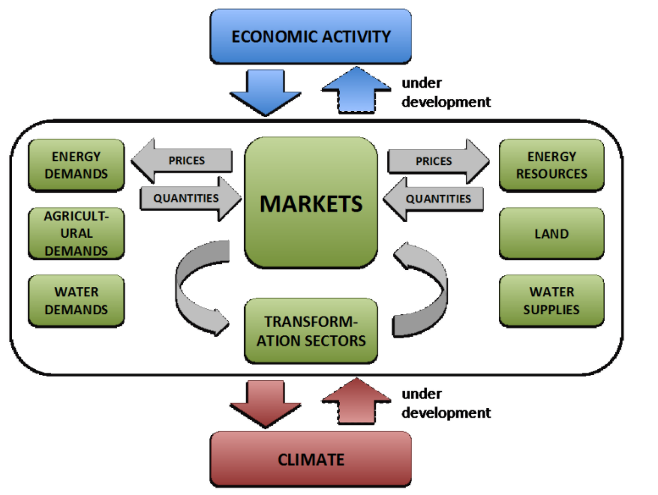
GCAM: Details of Model structure

Slide 10
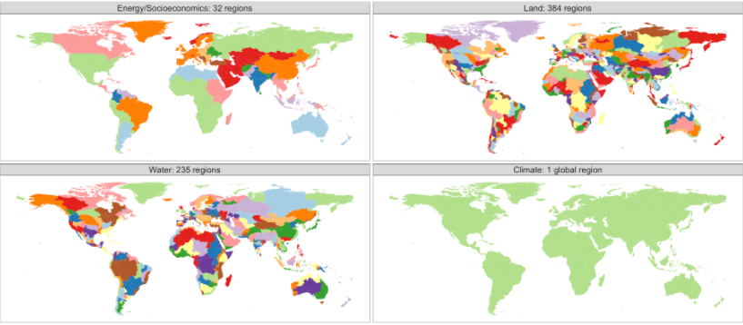
GCAM: Geospatial resolution

Slide 11
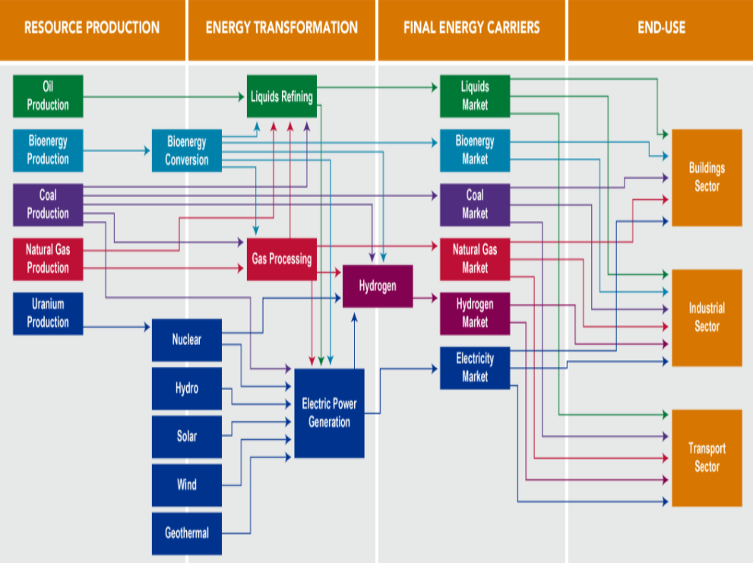
GCAM: Energy system

Slide 12
GCAM: Other modules
Emission Accounting
GCAM中的Emission Accounting采用的是CDIAC的Emission factor, 在空间时间精度上都有待提高（Possible integration: Life-cycle assessment）
Climate
GCAM，或者说IAM，常因其确定性模拟（deterministic optimization）受到批评，要在模型中引入不确定性或风险分析，气候的不确定性是必不可少的
Water
Land-use and bioenergy
Interregional trade
No interregional trade of secondary energy commodity

Slide 13
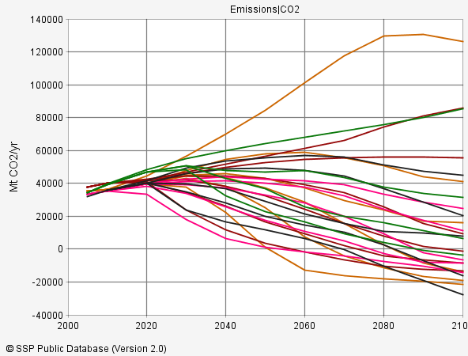
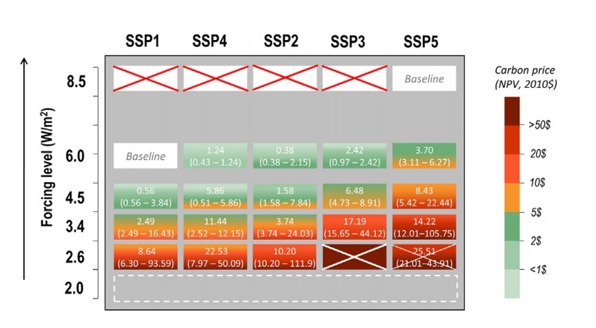
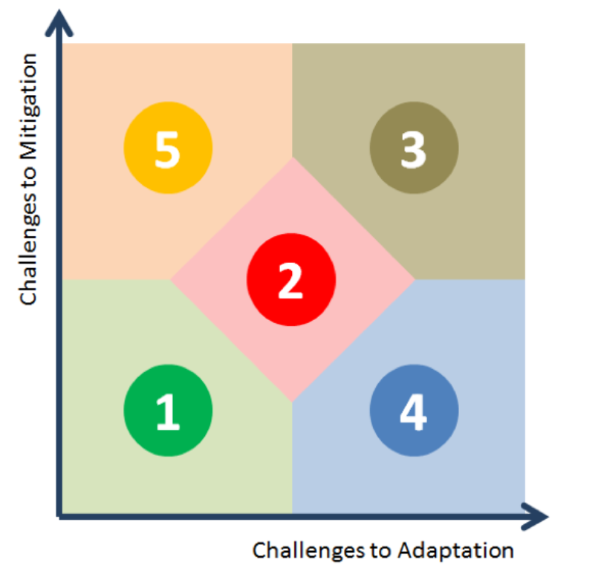
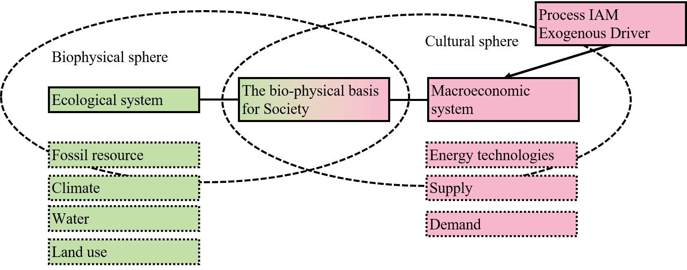
GCAM: GCAM与SSP-RCP气候变化情景框架

Slide 14
3
GCAM simple tutorial
3.1
GCAM file system
Table of Contents
3.2
System environment and quick start
3.3
Policy setting
3.4
Techno-economic assumption

Slide 15
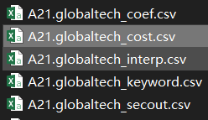
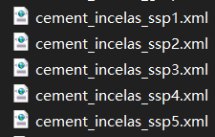
GCAM file system
gcamdata (CSV files + R)
Tech learning Curve
Tech Parameters
Macro economic variables
Geographic classification
Other demand assumptions
Raw data
Structured data
(xml files)
Carbon tax
Climate target
RES
Export and Visualization
Policy target file
Path finding
(optimization)
Model interference
rgcam (R package)
gcam_reader (python package)
Output
gcamcore (C++)

Slide 16
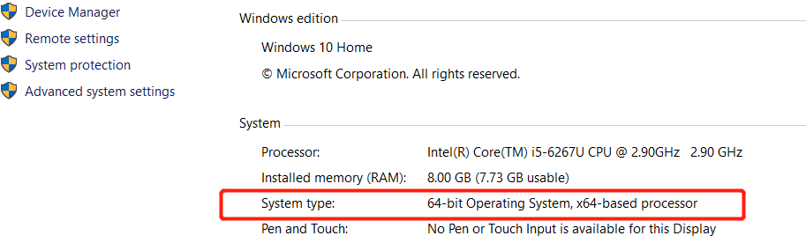
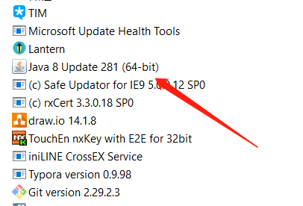
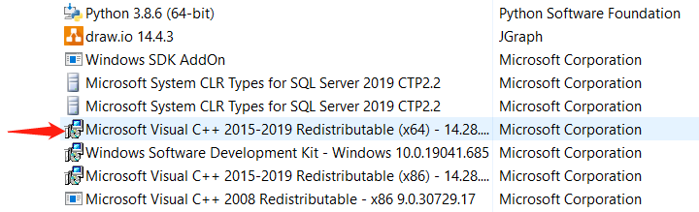
gcam-core system environment & quick start
System environment:
Windows 64bits
Check: Control panel → System and security → System
Java 64bits
Window C++ redistributable 15 or above
Check: Control panel → Program

Slide 17
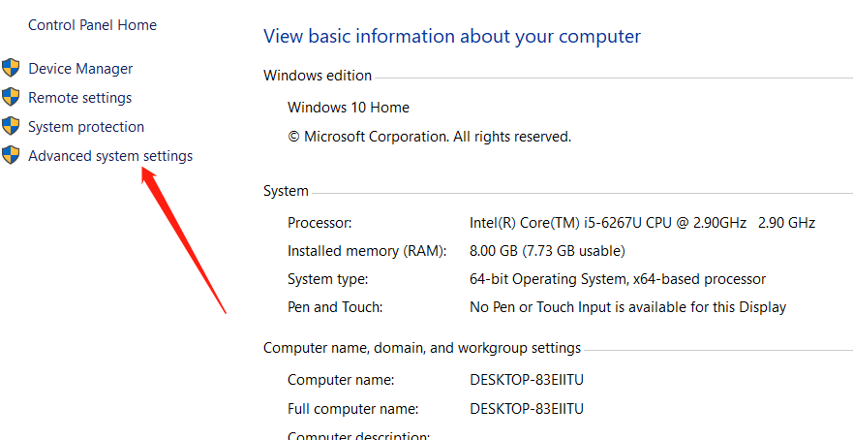
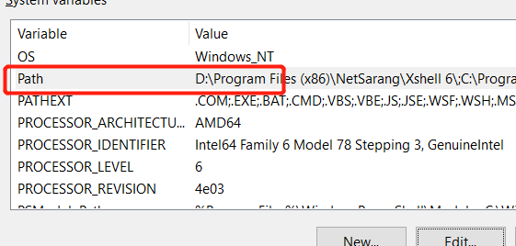
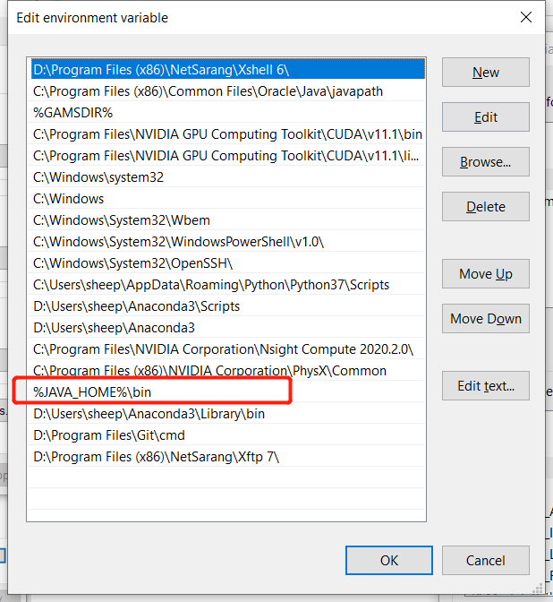
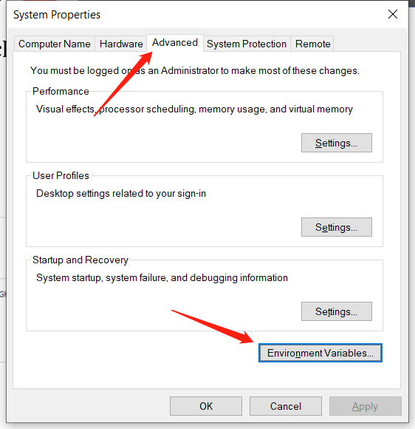
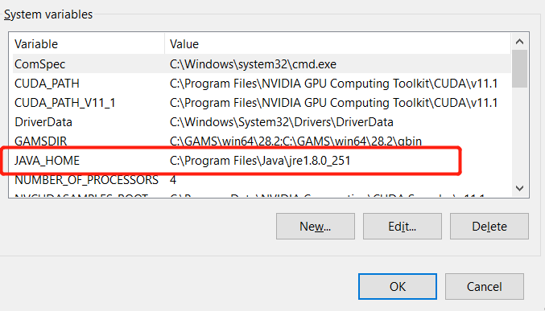
gcam-core system environment & quick start
Java 8 path setting:
Control panel → System

Slide 18
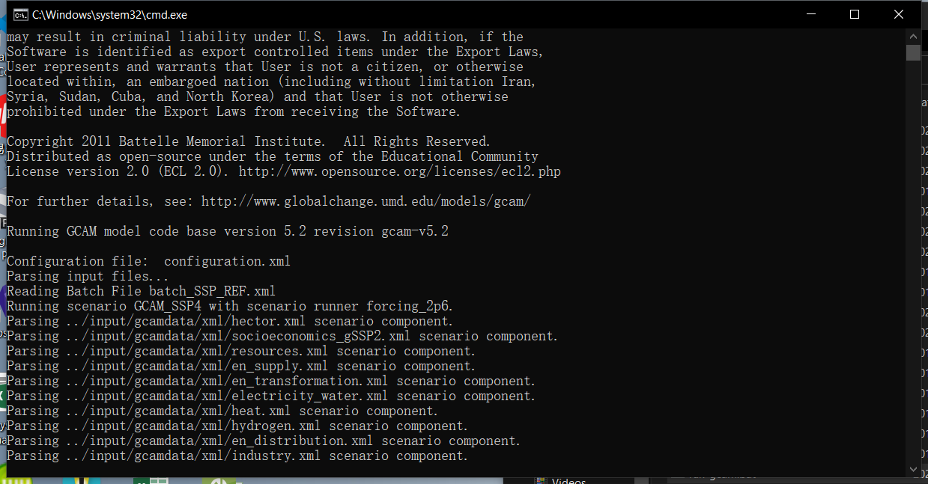
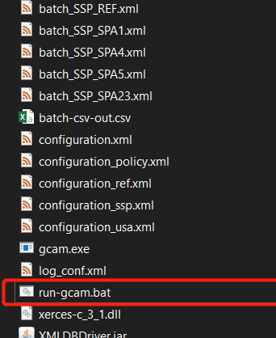
gcam-core system environment & quick start
Enter: [gcam 5.2 directory] → exe
右键记事本打开
批导入xml
模型运行参数确认
双击运行模型

Slide 19
Exogenous policy driver
Emission-related Policy:
Carbon or GHG prices
Emission constraints (Total amount)
Climate constraints
Energy production policy:
in quantity for the whole system
in percentage or quantity for any individual sector
Land-use policy:
Applying a carbon price on land-use emissions or not
Protected land

Slide 20
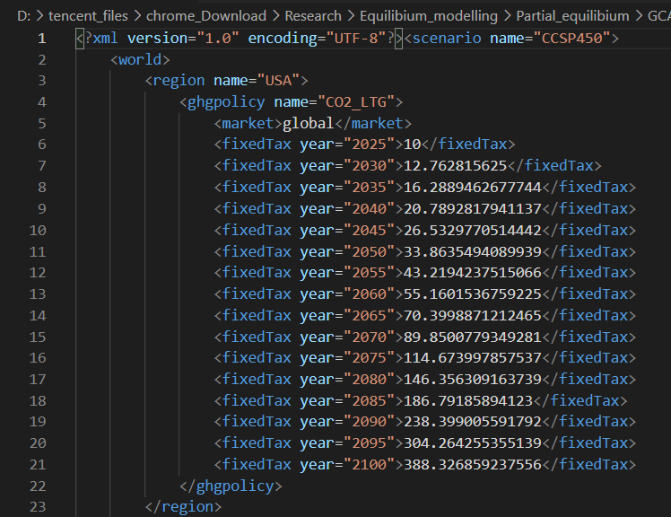
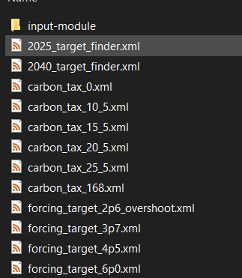
Exogenous policy driver: Add policy files
Enter: [gcam5.2 directory]/input/policy
Exemplary Policies
Double click open (recommend Visual Code)

Slide 21
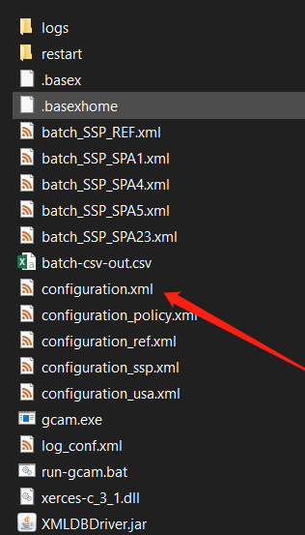
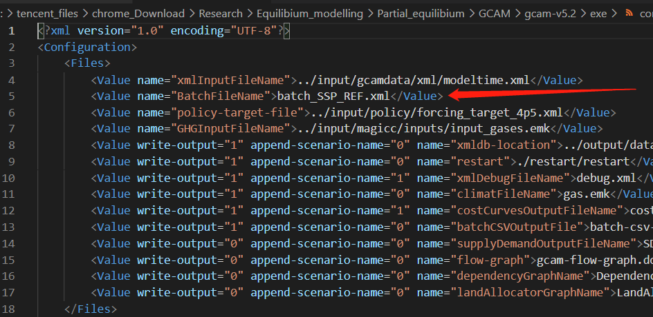
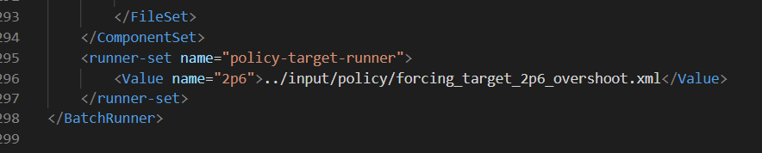
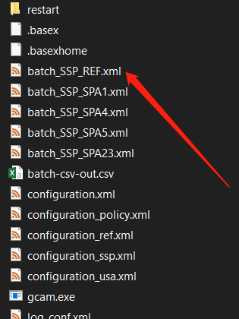
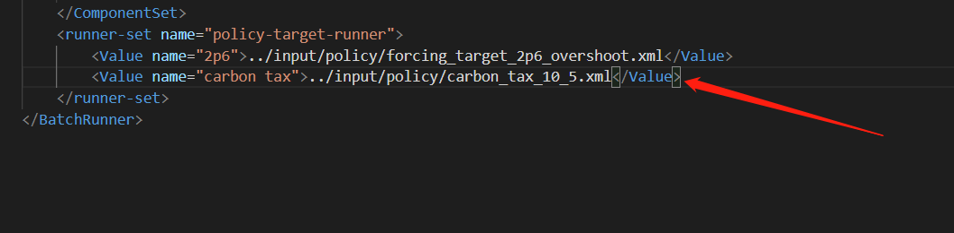
Exogenous policy driver: change configuration file
Enter: [gcam5.2 directory]/exe

Slide 22
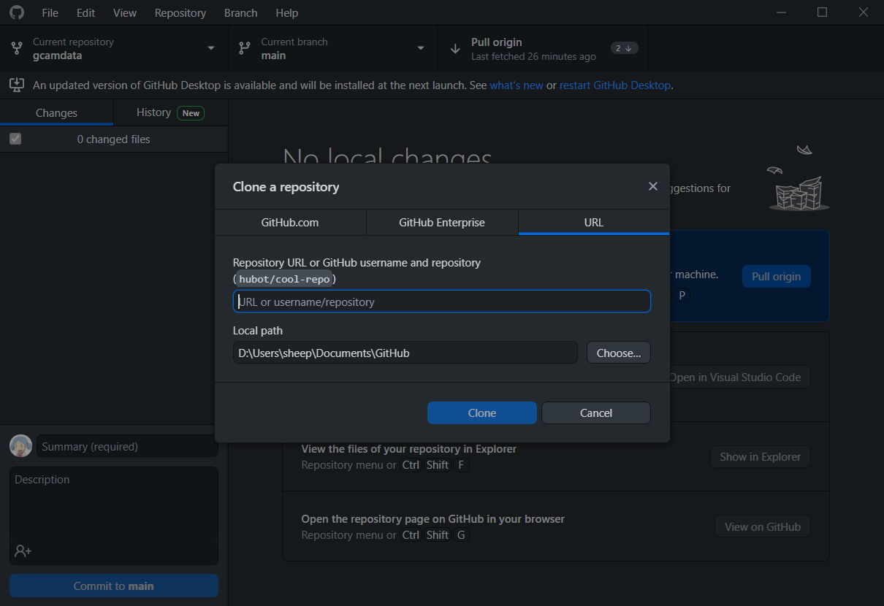
gcamdata: changing Techno-economic Assumptions
Gcam文件中自带的../input/gcamdata是目前使用的gcamdata系统是5.1版本的
直接使用导致文件版本不匹配，程序报错
从Github (https://github.com/JGCRI/gcamdata) 中直接下载gcamdata (推荐使用github desktop)
进入Github desktop → Ctrl+shift+O → 输入gcamdata github网址 → Clone

Slide 23
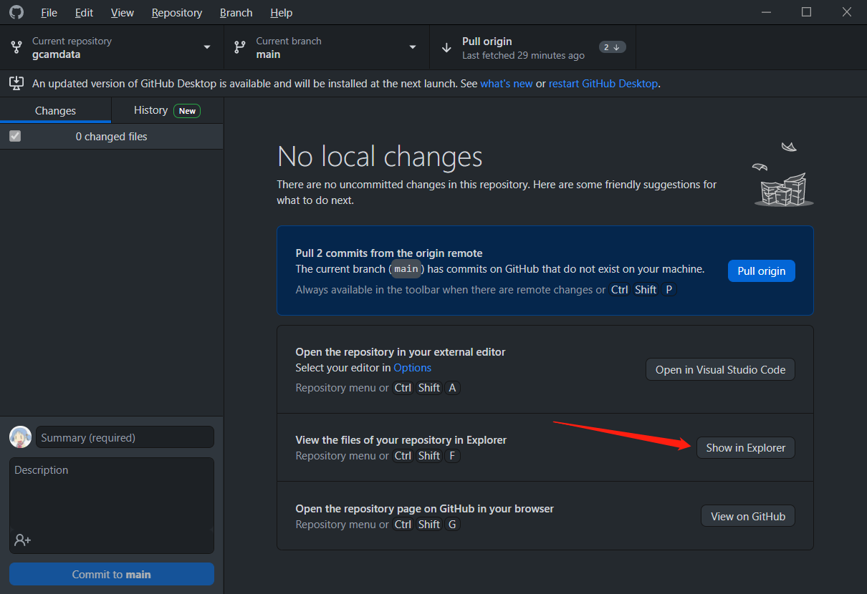
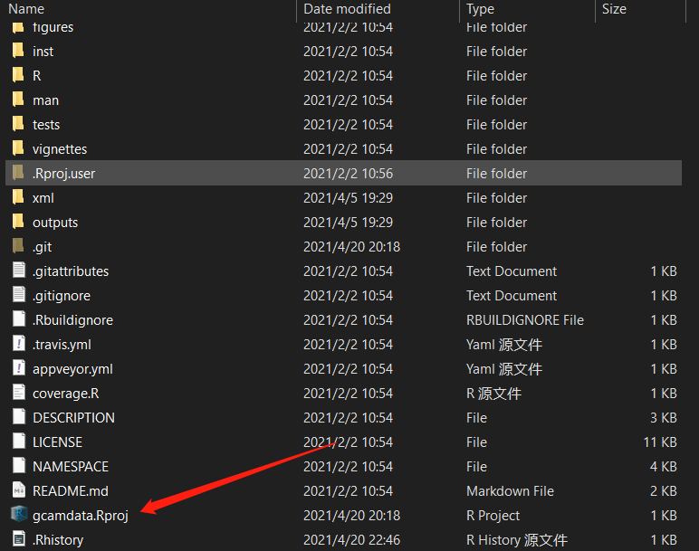
gcamdata: changing Techno-economic Assumptions
输入用CSV文件
输出xml文件

Slide 24
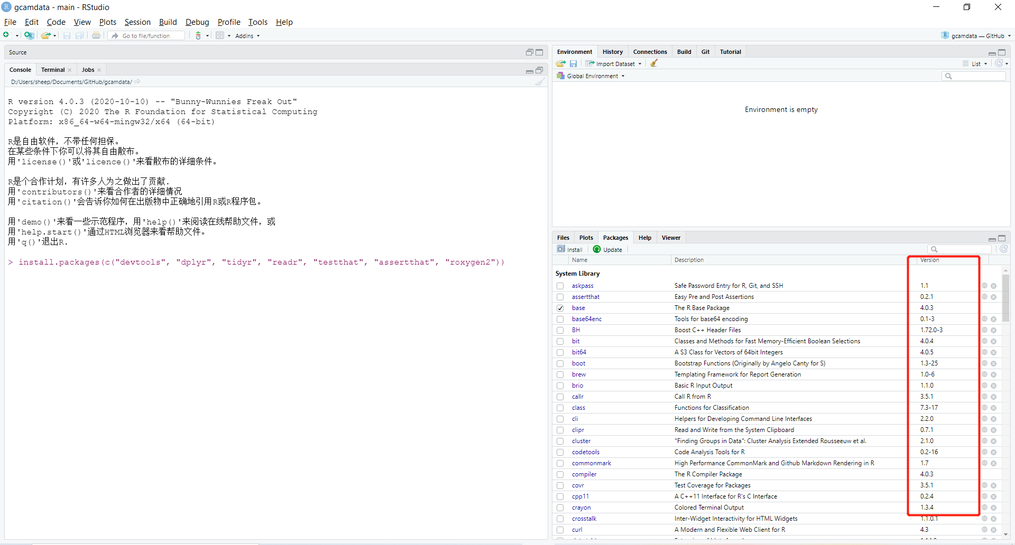
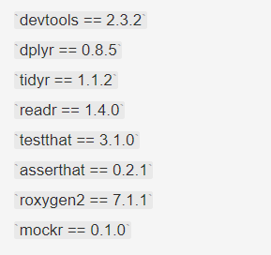
gcamdata: changing Techno-economic Assumptions
安装R studio & R lang (须为3.2版本以上)
配置GCAM依赖包
交互式指令行中输入
install.packages(c("devtools", "dplyr", "tidyr", "readr", "testthat", "assertthat", "roxygen2"))
devtools::install_github("krlmlr/mockr")
Package version:
3. Build → Load All
4. 交互式命令行中输入:
Driver()

Slide 25
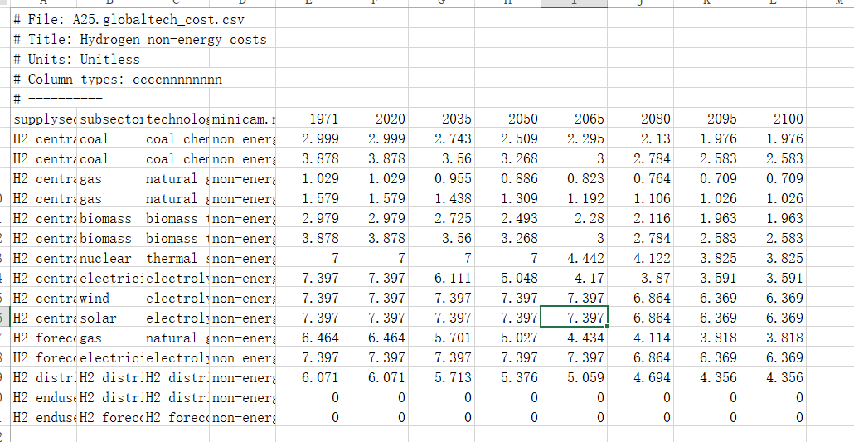
gcamdata: changing Techno-economic Assumptions
Gcamdata可以：
修改原有技术的技术经济参数
增加新的技术
增加新的地区 (https://github.com/JGCRI/gcamdata/wiki/Modifying-GCAM-via-the-Data-System)
修改原有技术的技术经济参数 (以氢能生产为例)
Enter gcamdata/inst/extdata/energy/A25.globaltech_cost.csv

Slide 26
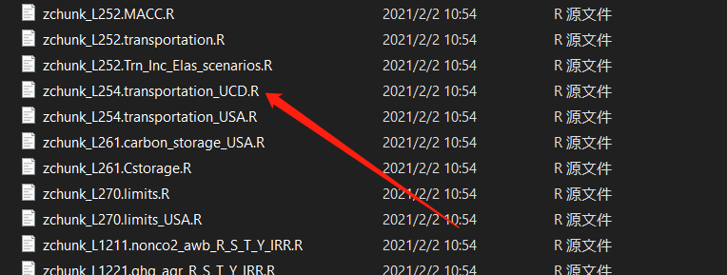
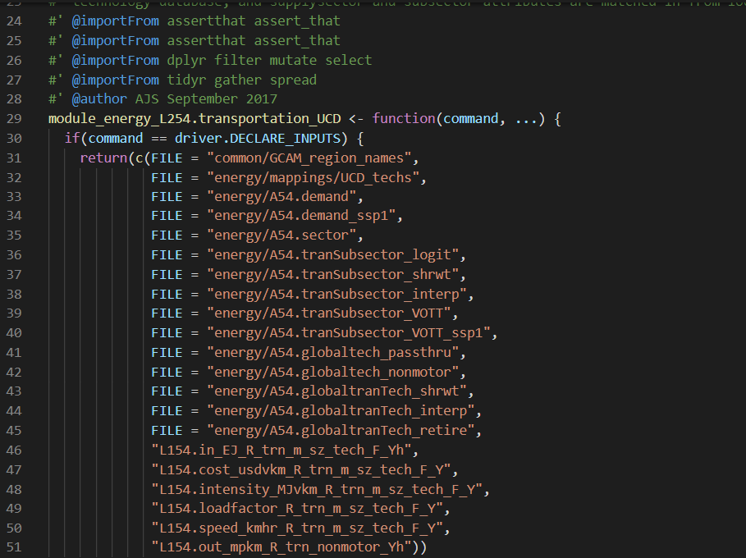
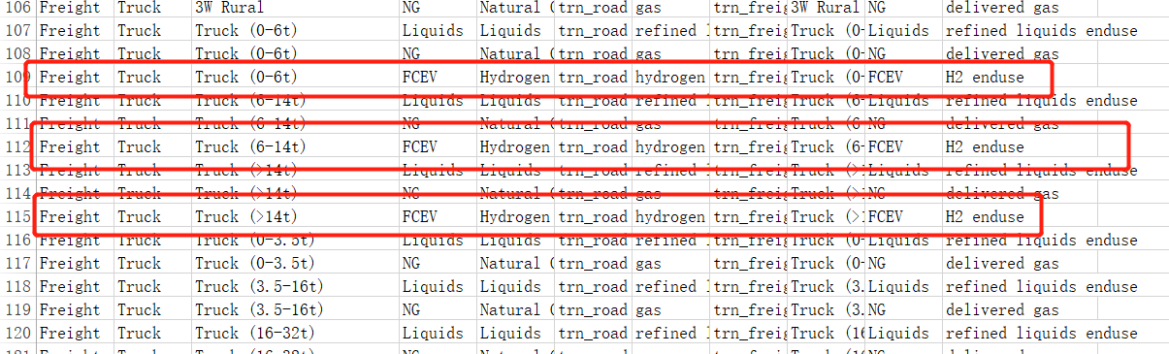
gcamdata: changing Techno-economic Assumptions
2. 增加新的技术(以交通部门增加生产为例)
找到所有与交通部门相关的文档
Enter gcamdata/R

Slide 27
gcamdata: changing Techno-economic Assumptions

Slide 28
Tutorials and Downloads
Microsoft C++ redistributable 2015 64-bit
https://support.microsoft.com/en-us/topic/the-latest-supported-visual-c-downloads-2647da03-1eea-4433-9aff-95f26a218cc0
Java 8 64-bit
https://www.oracle.com/java/technologies/javase-jre8-downloads.html
gcam_reader
https://github.com/JGCRI/gcam_reader
gcamdata
https://github.com/JGCRI/gcamdata

Slide 29
Thanks for listening

